Slide 1

White-box test technique
ISTQB Foundation

Slide 2
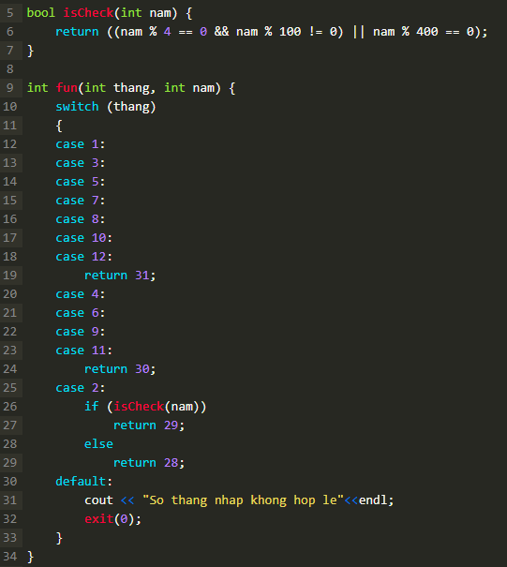
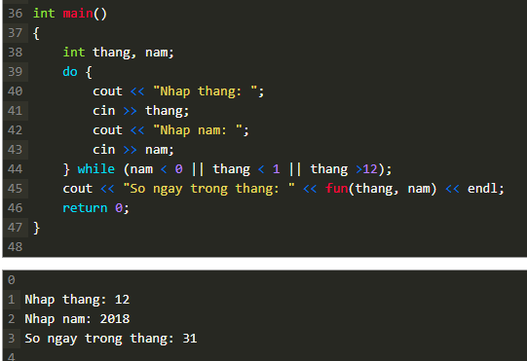
Example – list out all test-cases to test this code
Notes:
#include <stdio.h>
#include <string.h>
#include <iostream>
using namespace std;

Slide 3
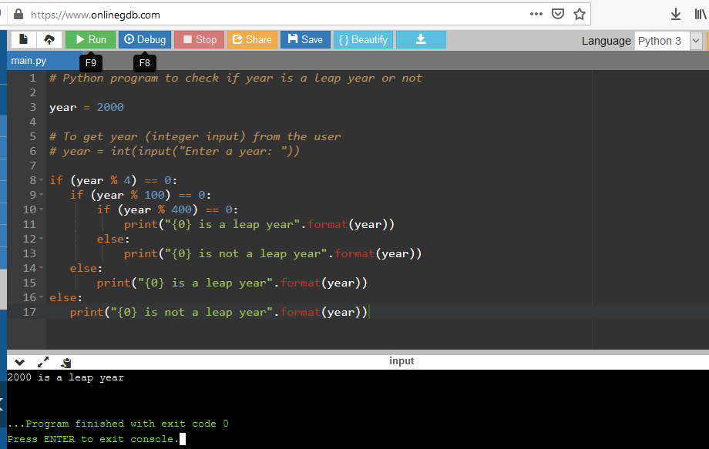
Some example of Python code
Use https://www.onlinegdb.com/
https://boxhoidap.com/tinh-so-ngay-trong-thang-python
https://www.programiz.com/python-programming/examples

Slide 4

What is Code coverage?
Code coverage is a measure which describes the degree of which the source code of the program has been tested. It is one form of white box testing which finds the areas of the program not exercised by a set of test cases. It also creates some test cases to increase coverage and determining a quantitative measure of code coverage.
Why use Code Coverage?
Here, are some prime reasons for using code coverage:
It helps you to measure the efficiency of test implementation
It offers a quantitative measurement.
It defines the degree to which the source code has been tested.
Notes:
Notes to presenter:
Description of what you learned in your own words on one side.
Include information about the topic
Details about the topic will also be helpful here.
Tell the story of your learning experience. Just like a story there should always be a beginning, middle and an end.
On the other side, you can add a graphic that provides evidence of what you learned.
Feel free to use more than one slide to reflect upon your process. It also helps to add some video of your process.

Slide 5
Statement Coverage
Decision Coverage
Statement testing exercises the potential executable statements in the code. Coverage is measured as the number of statements executed by the tests divided by the total number of executable statements in the test object, normally expressed as a percentage.
C0 - Statement Coverage: The percentage of executable statements that have been exercised by a test suite.
🡪 Achieving 100% decision coverage guarantees 100% statement coverage (but not vice versa)
Decision coverage reports the true or false outcomes of each Boolean expression. In this coverage, expressions can sometimes get complicated. Therefore, it is very hard to achieve 100% coverage.
C1 – Decision (Branch) Coverage: The percentage of executable decisions that have been exercised by a test suite
Notes:
Notes to presenter:
What was important about this learning experience?
How is it relevant to your course, yourself, or your society or community?
Why is this significant?
This SmartArt allows you add images and text to help outline your process. If a picture is worth a thousand words, then pictures and words should help you communicate this reflection on learning perfectly! You can always click on Insert>SmartArt to change this graphic or select the graphic and click on the Design contextual menu to change the colors.

Slide 6

Statement Coverage - What is Statement Coverage?
Statement coverage is a white box test design technique which involves execution of all the executable statements in the source code at least once. It is used to calculate and measure the number of statements in the source code which can be executed given the requirements.
Statement coverage is used to derive scenario based upon the structure of the code under test (được sử dụng để rút ra kịch bản dựa trên cấu trúc của mã được kiểm tra.)

Slide 7
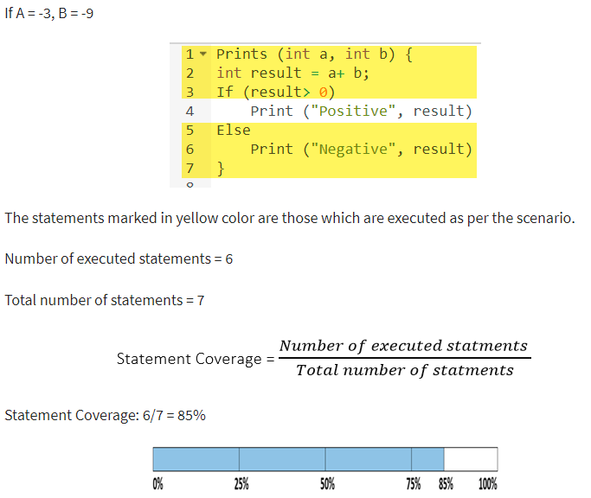
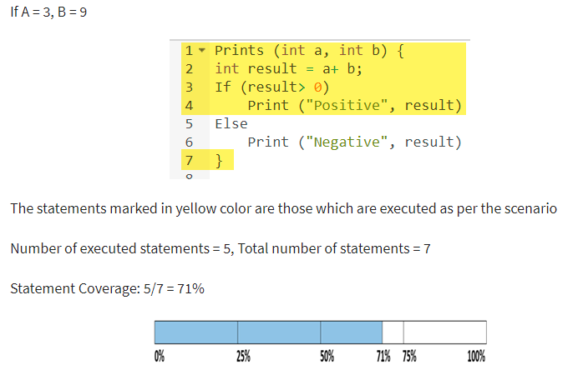
Example

Slide 8
What is covered by Statement Coverage?
Unused Statements
Dead Code
Unused Branches
Missing Statements

Slide 9

Decision Coverage
Decision coverage reports the true or false outcomes of each Boolean expression. In this coverage, expressions can sometimes get complicated. Therefore, it is very hard to achieve 100% coverage.
That's why there are many different methods of reporting this metric. All these methods focus on covering the most important combinations. It is very much similar to decision coverage, but it offers better sensitivity to control flow.

Slide 10
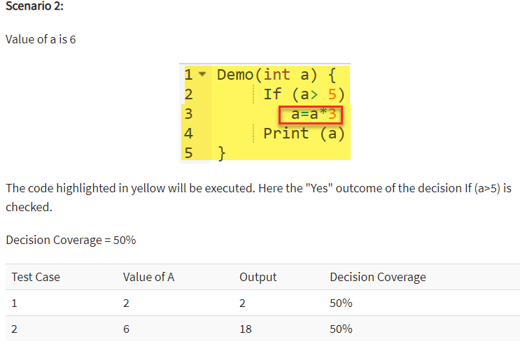
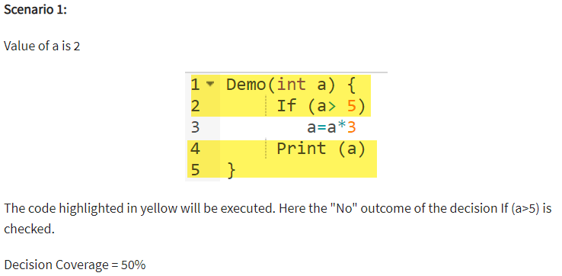
Example

Slide 11

Branch Coverage
In the branch coverage, every outcome from a code module is tested. For example, if the outcomes are binary, you need to test both True and False outcomes.
It helps you to ensure that every possible branch from each decision condition is executed at least a single time.
By using Branch coverage method, you can also measure the fraction of independent code segments. It also helps you to find out which is sections of code don't have any branches.
The formula to calculate Branch Coverage:

Slide 12
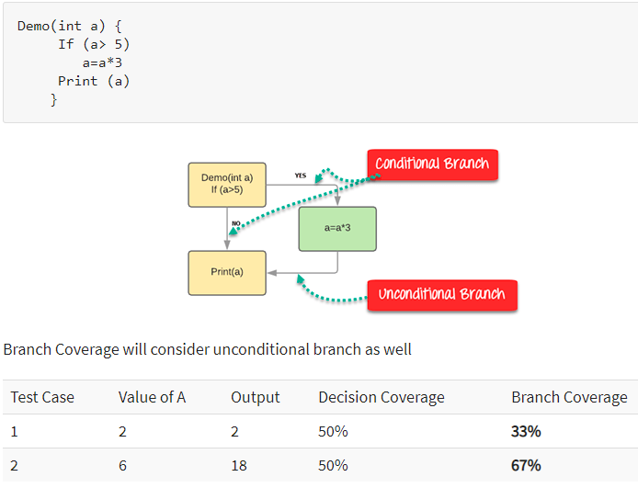
Example of Branch Coverage
To learn branch coverage, let's consider the same example used earlier
Consider the following code

Slide 13
What is the difference between statement coverage and decision coverage in software testing?
Statement Coverage is Number of code lines covered by your Test Case or Automation
100% Statement Coverage means you are touching every line of code.
Branch/Decision Coverage - Suppose you have a ‘if’ statement in your code, if has two decision True or False, so Number of decision you are covering is Decision Coverage
Now ambiguity comes that if every Statement Coverage is 100% will it implies 100% Branch Coverage - Answer is No e.g.
if(x>0)
print O;
exit;
Run this code with x=1 will result in 100% coverage but only True Decision is covered so for 100% Decision Coverage you need to run a test case with x=-1 to cover the False Decision also
Achieving 100% decision coverage guarantees 100% statement coverage (but not vice versa).

Slide 14

Experience Based Testing
"Knowledge gained through experience is far superior and many times more useful than bookish knowledge" - Mahatma Gandhi
Error Guessing
Exploratory Testing
01
In exploratory testing, informal (not pre-defined) tests are designed, executed, logged, and evaluated dynamically during test execution
Error guessing is a technique used to anticipate the occurrence of errors, defects, and failures, based on the tester’s knowledge
02
03
Checklist-based Testing
In checklist-based testing, testers design, implement, and execute tests to cover test conditions found in a checklist
Notes:
Notes to presenter:
What did you think at first?
What obstacles did you encounter along the way?
How did you overcome those obstacles?
What images can you add to support your process?
This SmartArt allows you add images and text to help outline your process. If a picture is worth a thousand words, then pictures and words should help you communicate this reflection on learning perfectly! You can always click on Insert>SmartArt to change this graphic or select the graphic and click on the Design contextual menu to change the colors.
Feel free to use more than one slide to reflect upon your process. It also helps to add some video of your process.

Slide 15
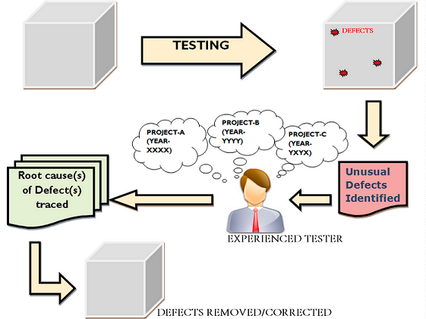
What is meant by the Experience Based Testing?
As of now, you all might have understood the basic meaning of "experience based testing". It is the technique of executing testing activities with the help of experience gained through several years of churning. Basically, a tester verifies and validates the software product quality using his/her past experience of testing the similar type of product in the respective domain.
Đến bây giờ, tất cả các bạn có thể đã hiểu ý nghĩa cơ bản của "thử nghiệm dựa trên kinh nghiệm". Đó là kỹ thuật thực hiện các hoạt động thử nghiệm với sự giúp đỡ của kinh nghiệm có được qua nhiều năm khuấy động. Về cơ bản, người kiểm tra xác minh và xác thực chất lượng sản phẩm phần mềm bằng kinh nghiệm trước đây của anh ấy / cô ấy về việc kiểm tra loại sản phẩm tương tự trong miền tương ứng

Slide 16
When Experience Based Testing is Required?
Experience is that precious tool of the tester, which is always required in performing all types of testing. However, there are certain circumstances, when a tester is left out with his/her past experience as the only resource to carry out the testing. Some of the expected situations are as follow:
Non-availability of requirements and specifications.
Limited Knowledge of the Software product.
Inadequate specification
Restricted amount of time, to perform testing.

